Slide 1
Lesson 10: Building Machine Learning Applications

Slide 2
Today's Agenda
End-to-End Machine Learning Process
MLOPS
Deploying Models to Production
Recap & Recommendations

Slide 3
Learning Objectives
Build and evaluate an end-to-end machine learning project

Slide 4
Machine Learning Everywhere
Machine Learning is increasingly applied across various industries to solve problems
Successful companies are moving more and more toward a data-driven culture, see this HBR article
Many internal and external stakeholders can be involved in a Machine Learning project

Slide 5

CRISP-DM
Source: https://en.wikipedia.org/wiki/Cross-industry_standard_process_for_data_mining

Slide 6
ML Ops
Business Drivers
Data Pipelines
Data Science
Model Deployment
Model Versioning
Source: https://en.wikipedia.org/wiki/Cross-industry_standard_process_for_data_mining

Slide 7
Business Drivers
Connect with stakeholders on low hanging fruits
Use Design Thinking, 10 Types of Innovation, LEAN, Six Sigma, etc
Direct and indirect measures and uncertainty around them
Choosing key metrics and benchmarks
Data collection, acquisition and preparation
Stating simplifying assumptions, constraints, granularity?
Are there ethical considerations that need to be addressed?
Technical aspects of the methodology (machine learning)
Technical aspects of the solution (operationalization)

Slide 8
Data Science
Keep stakeholders updated
Build prototypes
Log experiments
Iterate, iterate, iterate
Technology: Python, R

Slide 9
Model Versioning
Iteratively improve models
Feature engineering
Hyperparameters
Track and archive models
Track and archive data
Make it reproducible
Technology: Python, R

Slide 10
Model Deployment
Add models to workflows
Serve through APIs
Monitor performance
Automate deployment
Automate rollback
Technology: Spark, Docker, Kubernetes

Slide 11
Data Pipelines
Build robust pipelines
Operate on real-time data
Archive data
Technology: Kafka, MQTT, Avro, Thrift

Slide 12
Why MLOps

Slide 13
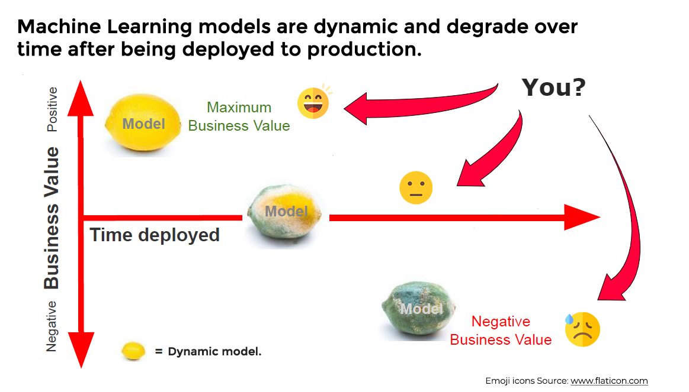
Source: https://neptune.ai/blog/how-to-monitor-your-models-in-production-guide

Slide 14
Why you need to monitor your Machine Learning models in production
Machine learning models are dynamic and sensitive to changes in the real world, and their performance tends to degrade over time.
Deploying a new model is akin to buying a new car: its value drops instantly, and its performance starts to decline as soon as it's put to use.
Deployment should not be viewed as the final step, as there is ongoing work to be done to maintain and improve the model's performance.
Regular reporting to business stakeholders is crucial to assess whether the deployed machine learning solution is effectively addressing the problem it was designed to solve.
Model monitoring after deployment is essential to ensure that it continues to perform as expected.
Updating the model to account for localized problems, such as geographic regions, is necessary for optimal performance.
The key takeaway is that the deployment of a machine learning model is just the beginning of the work involved in maintaining and improving its performance.

Slide 15
Why we need to monitor ML models
Reason | Description
Detecting Drift | Monitoring helps detect drift in the model's performance, which is caused by changes in the input data distribution or other factors. Drift can lead to inaccurate predictions and reduced effectiveness of the model.
Ensuring Fairness | Monitoring helps ensure that the model is making fair and unbiased predictions, particularly with respect to sensitive attributes such as race or gender. It can also detect biases that emerge over time due to changes in the data.
Improving Performance | Monitoring helps identify areas where the model's performance can be improved, such as by fine-tuning hyperparameters or adjusting the model architecture. It can also help identify which features are most important for making accurate predictions.
Ensuring Compliance | Monitoring helps ensure that the model is complying with relevant laws, regulations, and ethical guidelines. For example, in some contexts, models must be explainable, meaning that they can be audited and understood by human experts.
Enabling Debugging | Monitoring helps diagnose and debug issues that may arise with the model, such as unexpected errors or poor performance on certain inputs. It can also help identify when the model is making incorrect or surprising predictions.
Demonstrating Value | Monitoring helps demonstrate the value of the machine learning solution to stakeholders, by providing evidence of its effectiveness and identifying areas for improvement. It can also help justify the investment in the model by showing how it is contributing to the organization's goals.

Slide 16
ML Ops

Slide 17
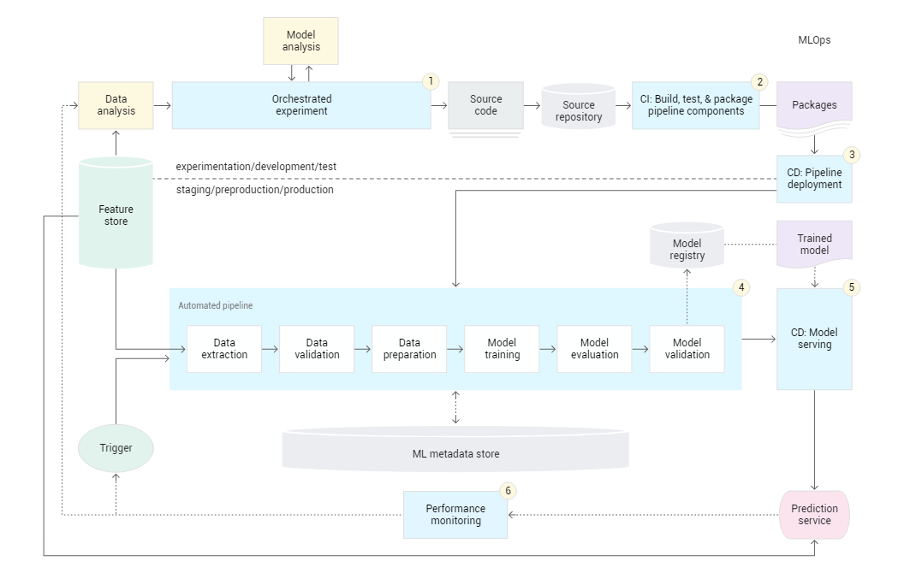
ML Ops Architecture

Slide 18
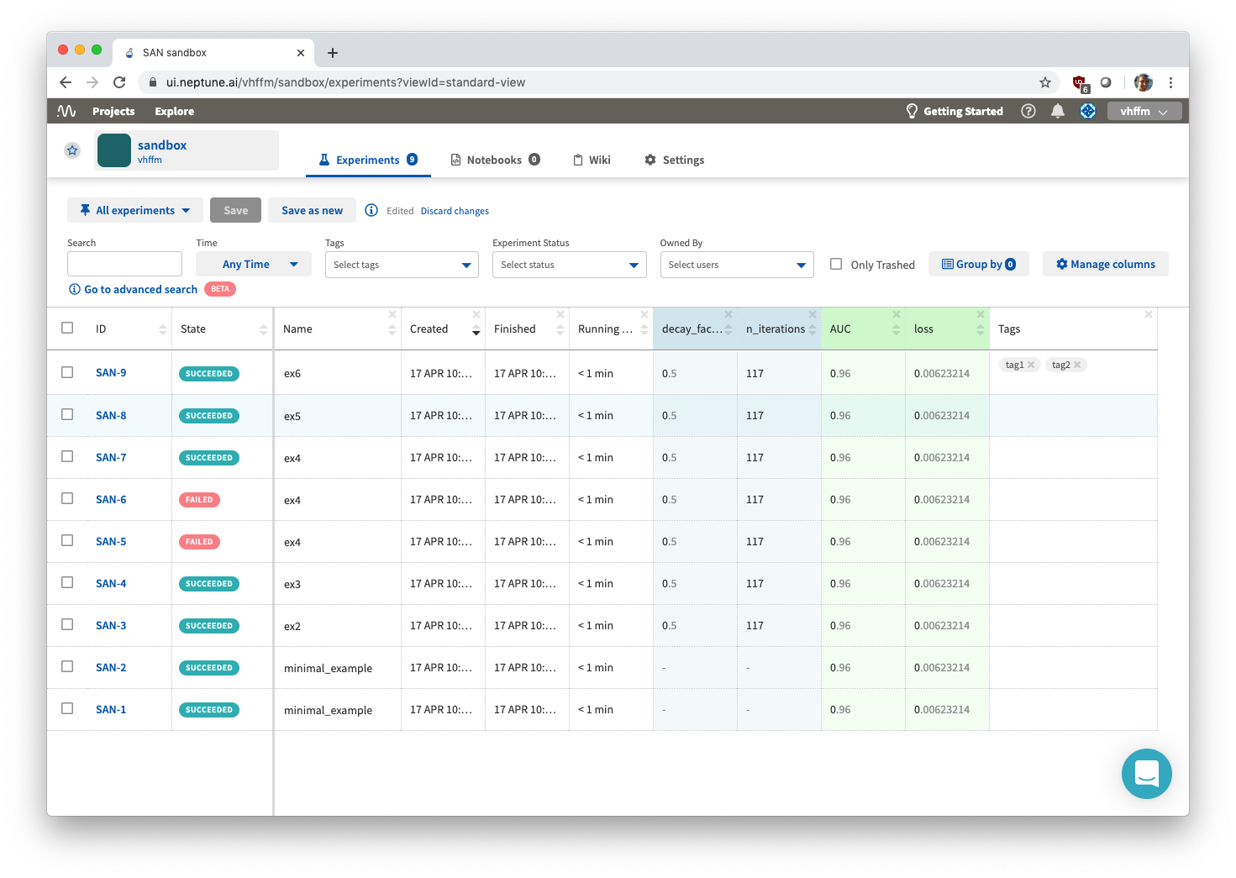
Neptune
Neptune is a tracker for experiments with focus on Python. It is a hosted service.
Experiments are tracked by using library hooks to register (model) parameters, evaluation results, and upload artifacts (such as models, hashes of training data, or even code). The library can track hardware usage and experiment progress.
The results can be analyzed and compared on a website. There are also collaborative options. Neptune has integrations with Jupyter notebooks, various ML libraries, visualizers (HiFlow, TensorBoard), other trackers (MLFlow), and external offerings (Amazon Sagemaker).
They provide an API to query results from experiment. This can be used to feed CI/CD pipelines for model deployment.
$ conda create --name neptune python=3.6
$ conda activate neptune
$ conda install -c conda-forge neptune-client
$ cd /somewhere
https://ui.neptune.ai/

Slide 19
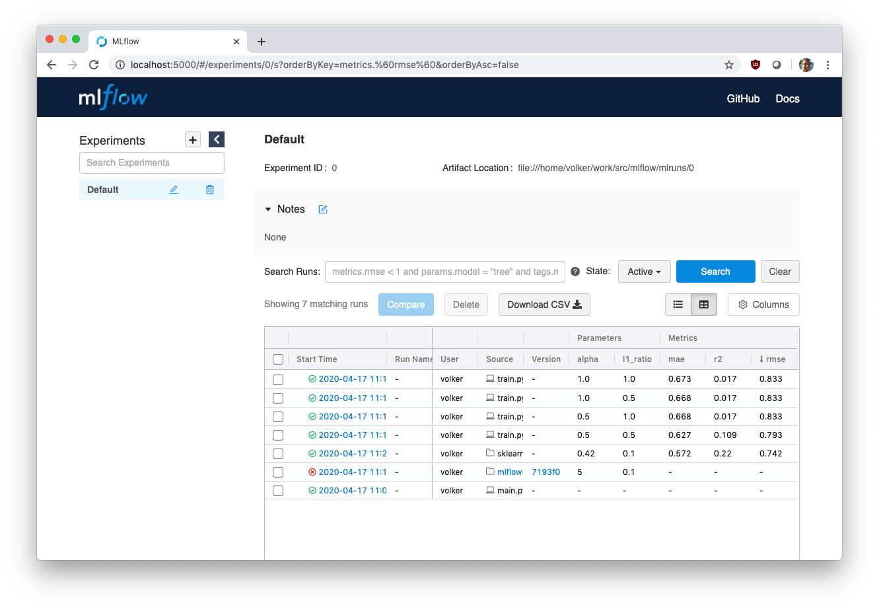
MLFlow
MLFlow is an experiment tracker and generic model server. It can be self-hosted.
Experiments are tracked by using library hooks to register (model) parameters, evaluation results, and upload artifacts (such as models, hashes of training data, or even code). Artifacts can be logged to local, remote, or cloud storage (S3, GFS, etc).
Results can be analyzed through a web UI and CSV export is available. Models are packaged as a wrapper around the underlying format (Sklearn, XGBoost, Torch, etc). They can be pushed to Spark for batch inference or served through REST.
There are CLI, Python, R, Java, and REST APIs for further integration with CI/CD pipelines. Models can be pushed to cloud services (SageMaker, AzureML, ...).
$ conda create --name mlflow python=3.6
$ conda activate mlflow
$ conda install -c conda-forge mlflow
$ cd /somewhere
$ mlflow ui
---> http://localhost:5000
https://mlflow.org/docs/latest/quickstart.html

Slide 20
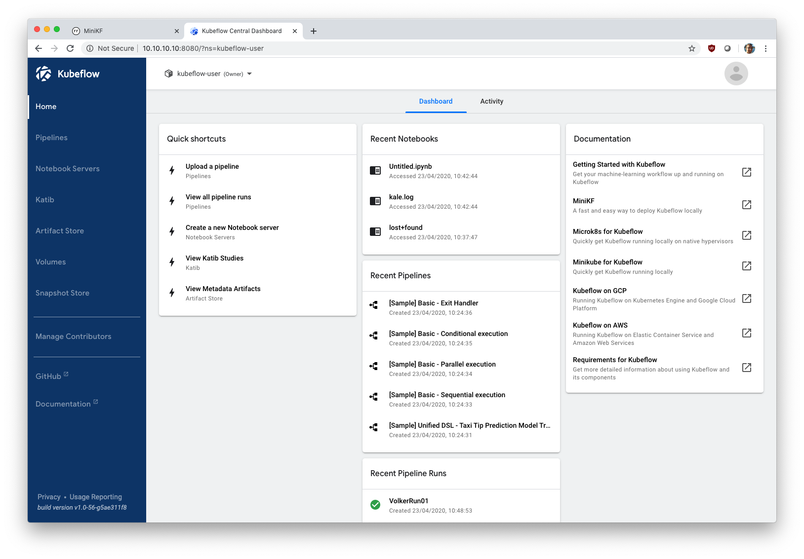
Kubeflow
Kubeflow is essentially a self-hosted version of the Google AI platform. It uses Kubernetes to abstract away infrastructure.
Kubeflow can deploy Jupyter notebooks, run pipelines for data processing and model training (scheduled, on-demand), organize runs, archive models and other artifacts, and expose models through endpoints. Pipelines are compute graphs and are described in Python with a DSL. Their components are wrapped as Docker images.
It integrates with GCP so it can elastically scale to the cloud compute and storage (e.g., distributed model training). It also integrates with offerings such as BigQuery or Dataproc.
The solution is heavy and complex but enables rapid scale-out. It is especially applicable if infrastructure is already managed through Kubernetes.
https://www.kubeflow.org/docs/started/workstation/getting-started-minikf/
$ cd /somewhere
$ vagrant init arrikto/minikf
$ vagrant up
---> http://10.10.10.10

Slide 21
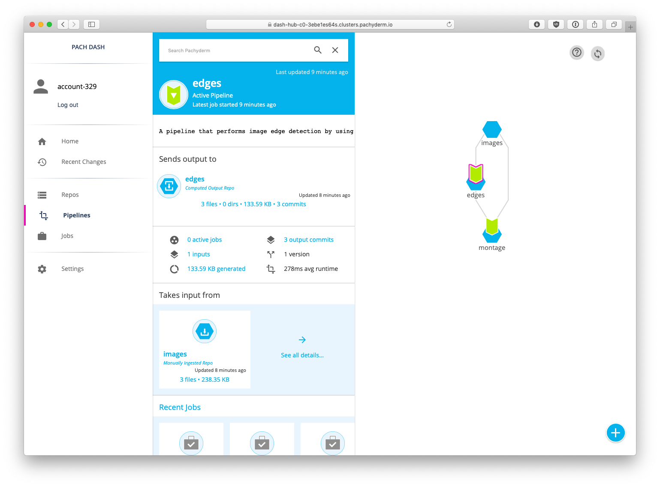
Pachyderm
Pachyderm is a versioning system and execution environment for data and processing pipelines. Hosted and self-hosted options exist.
At its core is data provenance. Data is committed to a repository and acted upon by processors in pipelines. The results (data and other artefacts like models) are committed back into a repository. By design, all use of data is traceable through pipelines. Pipelines are described in JSON and processors are packaged as Docker images. Pachyderm can integrate (but not deploy) Jupyter and can push/pull data from cloud stores (S3, etc).
Pachyderm is built on top of Kubernetes, so can easily scale-out and run in various clouds. Self-hosting comes with the usual Kubernetes complexity.
$ cd /somewhere
$ download from (https://github.com/pachyderm/pachyderm/releases)
$ tar xfvz release_filename_linux_amd64.tar.gz
$ pachctl version --client-only
https://docs.pachyderm.com/latest/pachub/pachub_getting_started/
https://docs.pachyderm.com/latest/getting_started/beginner_tutorial/

Slide 22
Common ML Ops Functionality
Model versioning and tracking
Automated deployment
Continuous integration and continuous deployment (CI/CD)
Model monitoring and performance tracking
Data management and versioning
Model retraining and updating
Model explainability and interpretability
Collaboration and governance
Automated testing and validation
Error tracking and logging

Slide 23
ML deployment options
Cloud deployment
Client deployment
Hybrid deployment

Slide 24
Cloud deployment
Set up a web server that can accept requests from clients, run them through an inference pipeline, and return the prediction results.
Two common workflows:
Streaming API: accept prediction requests as they come and process them immediately.
Batch: process a large number of prediction requests all at once.

Slide 25
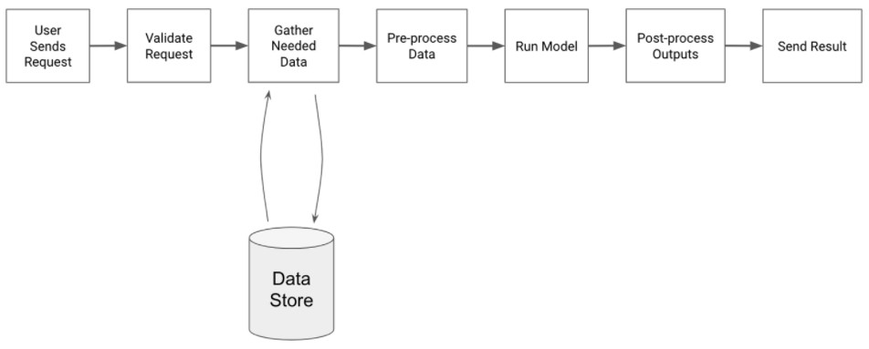
Cloud deployment – streaming API
Streaming API workflow is good for scenarios that requires ML model’s predictions to be available with low latency. Think about search engines.
Common steps:

Slide 26
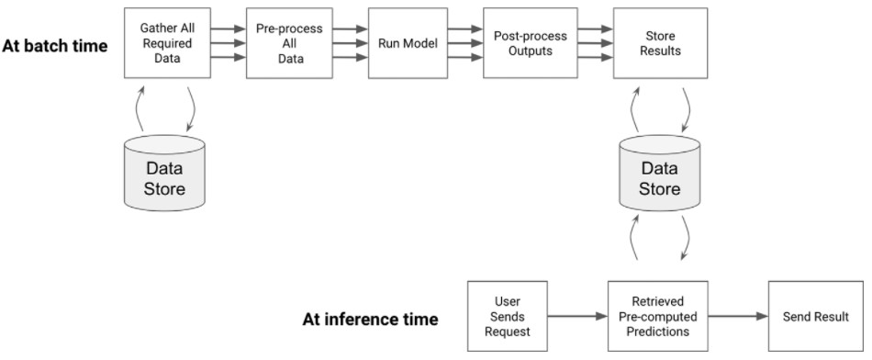
Cloud deployment – batch
Batch workflow is good for scenarios when we have access to model features before the model prediction is required. Think about house price prediction model.
Common steps:

Slide 27
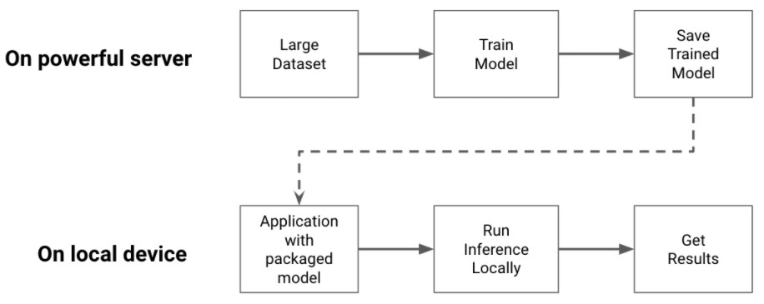
Client deployment
Run all model predictions on the client, e.g. computers, tablets, smartphones, IoT devices.

Slide 28
Client deployment
Benefits:
No data transmission back to the cloud.
Very low latency time of making a prediction.
Work even without internet access.
Privacy protection of users’ sensitive data.

Slide 29
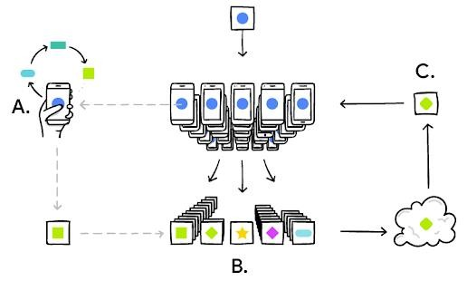
Hybrid deployment – federated learning
A seamless integration between cloud and client deployment:
Each client trains its own model locally based on their user’s data, and send aggregated updates to the cloud.
The cloud server improves its global model based on individual updates, and push the new model back to each client.
An exciting direction that powers
Google’s mobile keyboard predictions: https://ai.googleblog.com/2017/04/federated- learning-collaborative.html

Slide 30
Recap

Slide 31
Recap: ML steps covered so far
Problem understanding data collection
Decision trees
Ensemble models Logistic regression SVM
Deep learning models Time series models Recommender systems
Train/tune/test sets Cross-validation
Exploratory data analysis
Feature engineering and data pre- processing
Model selection and hyper- parameter tuning
Model output
Deploy
Data split
Model
evaluation
Classification metrics Model explainability
Datetime features Numeric features Categorical features

Slide 32
General advices for ML practice
Do you build an ML model for people, or for machines?
80/20 rule: grasp deep knowledge to solve 80% of all problems.
Human judgement is influential.
When you have a problem at hand, always start thinking how a human domain expert would solve it manually.
What is the human error rate (especially for tasks in image, text, etc.)?
Simpler is better.
Do you really need a deep learning model?
Do you really need an ensemble model?

Slide 33
Tip #1: don’t overlook the power of linear models
They are computationally efficient, and can model non- linear relationships via feature transformations.
Popularly used among production systems in industry (together with other techniques).
Facebook (ads click prediction): https://research.fb.com/publications/practical-lessons-from- predicting-clicks-on-ads-at-facebook/
Google (recommender system at Google Play store): https://arxiv.org/abs/1606.07792

Slide 34
Tip #2: improve performance with more feature engineering
Feature engineering, together with data pre-processing are more important than sophisticated ML models.
In practice, start by trying “two extremes” as baselines:
“Performance floor”: fit a naïve linear model.
“Performance ceiling”: fit a complex model like ensemble learning.
Perform more feature engineering to improve model performance.

Slide 35
Tip #3: model interpretability is important
In the field of statistics, model interpretability is never a problem because it’s required ☺
In the field of machine learning, model interpretability is also required but often overlooked ☹
Interpretability builds trust with stakeholders.
Interpretability speeds up model debugging.

Slide 36
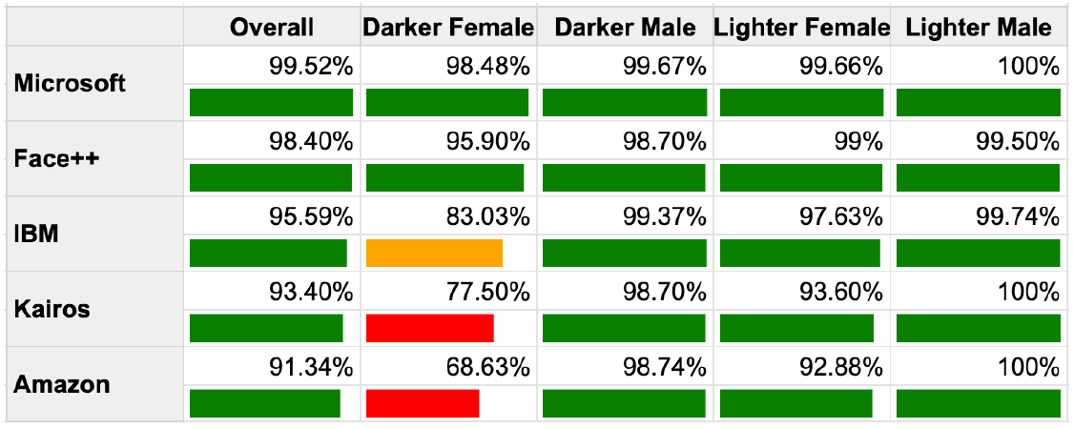
Tip #4: error analysis is often overlooked
An overall measure of accuracy often hides the details.
Error analysis: on what population the model makes more errors?
Example: face detection comparison across APIs, conducted by Inioluwa Deborah Raji et al (as of August 2018).

Slide 37
Ethics of Artificial Intelligence (AI)
Microsoft: https://www.microsoft.com/en-us/ai/responsible- ai
Google: https://ai.google/responsibilities/
IBM: https://www.ibm.com/watson/ai-ethics/
PwC: https://www.pwc.com/gx/en/issues/data-and- analytics/artificial-intelligence/what-is-responsible-ai.html

Slide 38
Farewell, and stay connected ☺
Please complete the end course survey on Canvas.
I will submit your final grades one week after the final assignment due date.
Thank you for all your patience and feedback!
Farewell, and stay connected

